Slide 1
Squirrels and their territory acquisition
By Ariane, Xuehai, Eula, Yao-Chi

Slide 2
Background Information

Slide 3
Background
Dataset based on a long-term study of wild North American red squirrels (27 years) in Yukon, Canada, focused on survival, reproduction, and population dynamics.
Why study territory acquisition?
Studying territory acquisition is crucial for understanding ecological balance, species interactions, resource use, and ecosystem stability.
Notes:
Supplementary data includes white spruce cone availability (LaMontagne et al.), predator abundance, and alternate prey from regional monitoring.

Slide 4
Hypothesis and predictions

Slide 5
Hypothesis
Male and female juvenile North American red squirrels (Tamiasciurus hudsonicus) differ in their likelihood of acquiring a territory and sex is the biggest factor that affects whether they can acquire a territory.

Slide 6
Prediction
One sex (male or female) might have a higher likelihood of acquiring a territory.
Sex is the biggest factor that affects whether they can acquire a territory.

Slide 7
Method

Slide 8
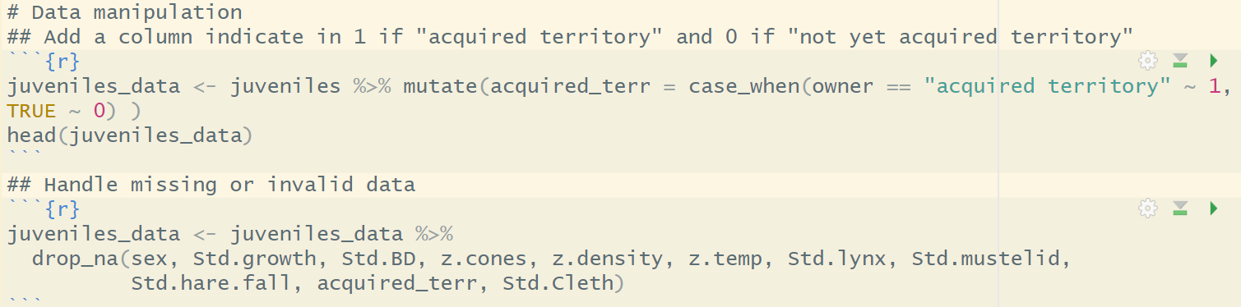
For Prediction 1:
One sex (male or female) might have a higher likelihood of acquiring a territory.
Data manipulation
Converted the "owner" column into a binary variable "acquired_terr" (1 = acquired territory, 0 = not).
Handled missing or invalid data

Slide 9
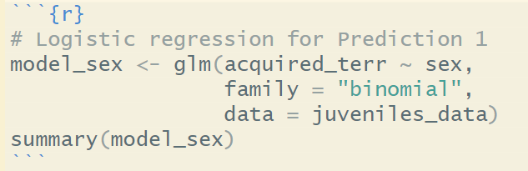
2. Exploratory data analysis
Used logistic regression to see the odds of acquiring territory between males and females
This will include the significance difference in the likelihood of acquiring a territory between sexes

Slide 10
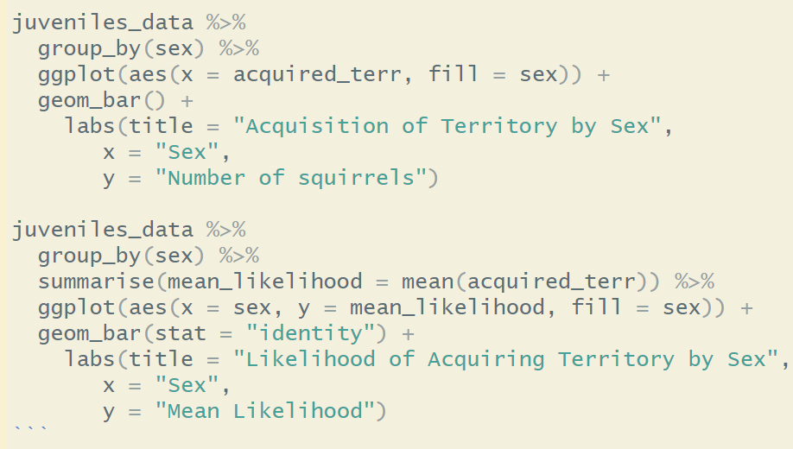
3. Visualize the likelihood of territory acquisition by sex
Used bar plot

Slide 11
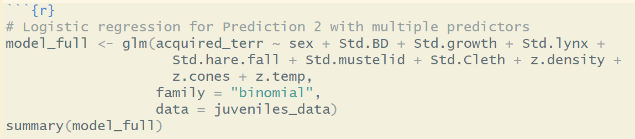
For Prediction 2:
Sex is the biggest factor that affects whether they can acquire a territory.
Performed logistic regression with multiple predictors
sex, std. birthdate, std. growth, std. lynx, std. hare, std. mustelid, std. Cleth, z. density, z. cones, z. Temperature
Not considering combined effects

Slide 12
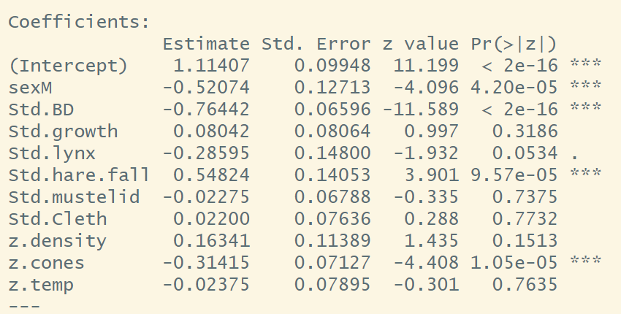
2. Evaluated the significance of each predictor using p-values to determine whether sex is the most influential factor.

Slide 13
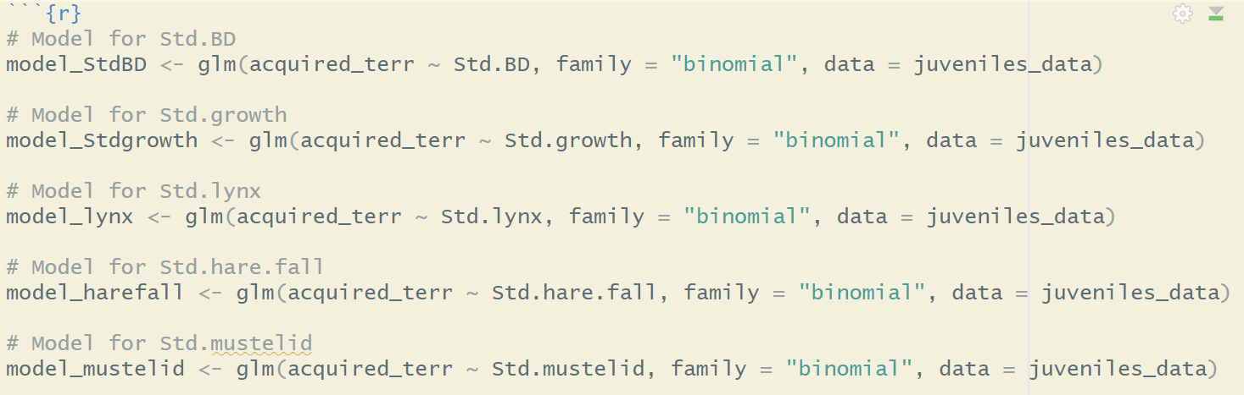
3. Conducted logistic regression with individual predictors and models including interactions between predators and prey.

Slide 14
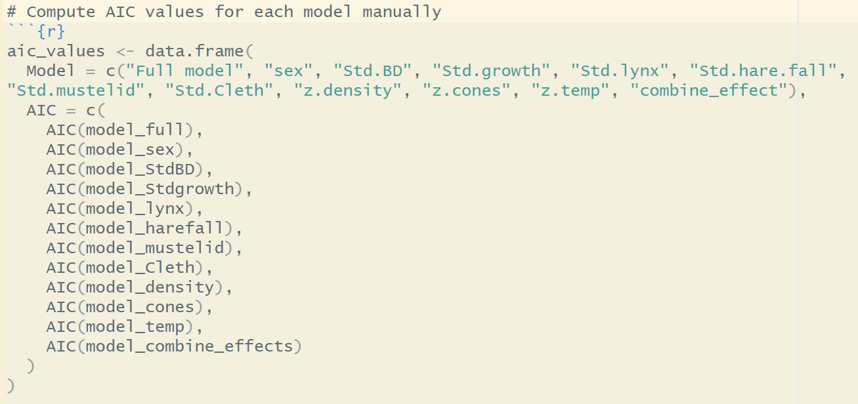
4. Compared these models with the “full” model using Aikake Information Criterion (AIC) to identify the most significant factor that influences territory acquisition in squirrels.

Slide 15
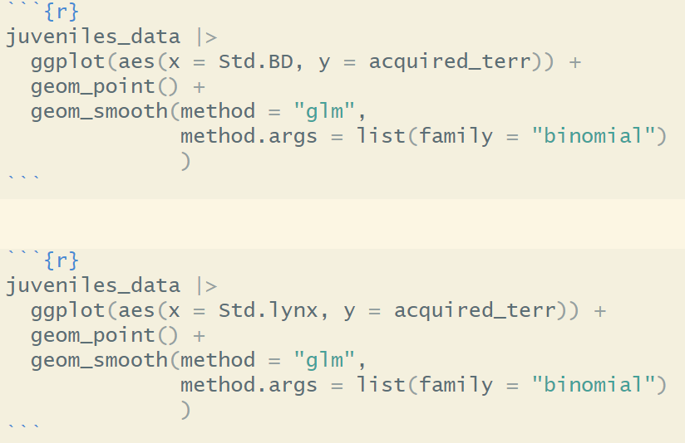
5. Visualized the effects of predictors on territory acquisition.

Slide 16
Results

Slide 17
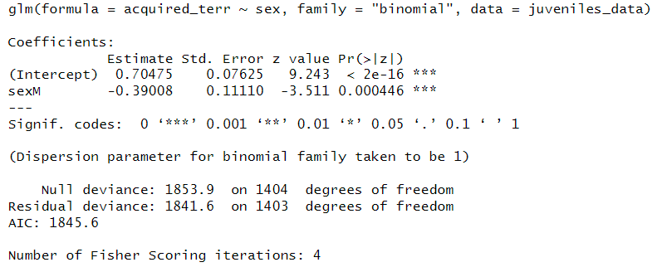
For Prediction 1:
Males have lower odds of acquiring a territory (sexM coefficient = -0.39, p = 0.000446).

Slide 18
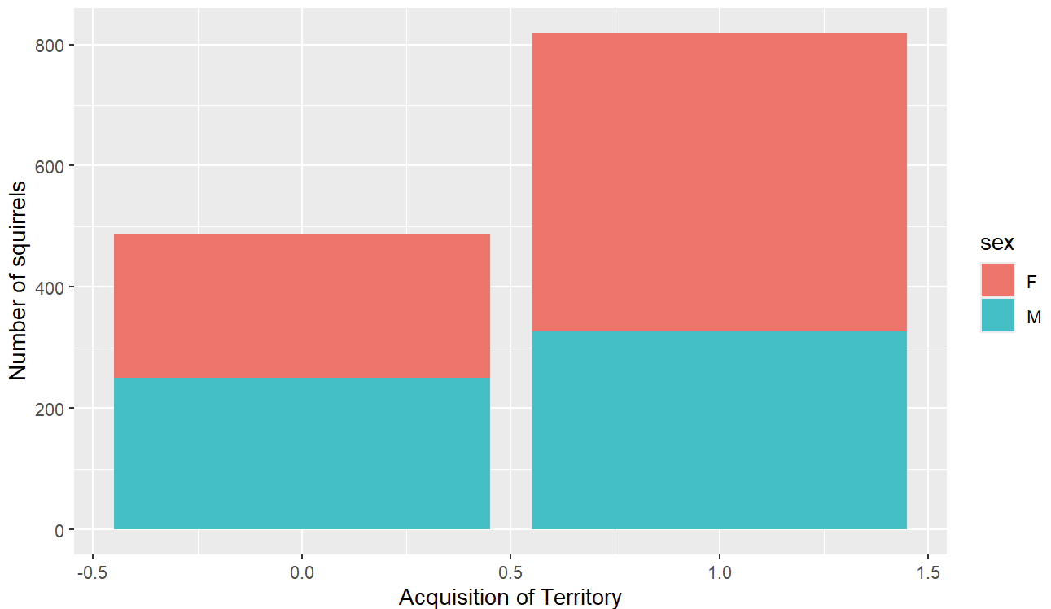
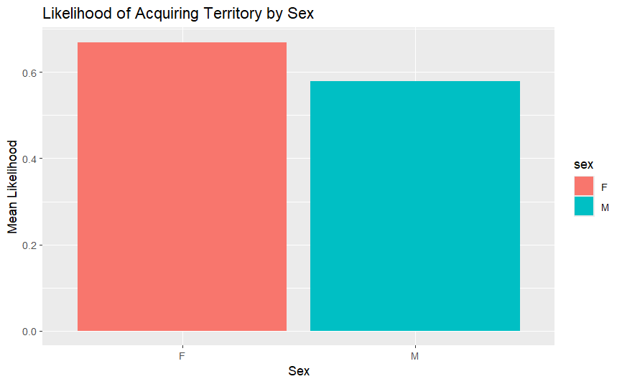
For Prediction 1:
Males have lower odds of acquiring a territory (sexM coefficient = -0.39, p = 0.000446).
Females have a higher likelihood in the graph.
Conclusion: The null hypothesis that there is no difference in the likelihood of territory acquisition between males and females is rejected.
Notes:
Females have a higher likelihood of acquiring a territory than males.

Slide 19
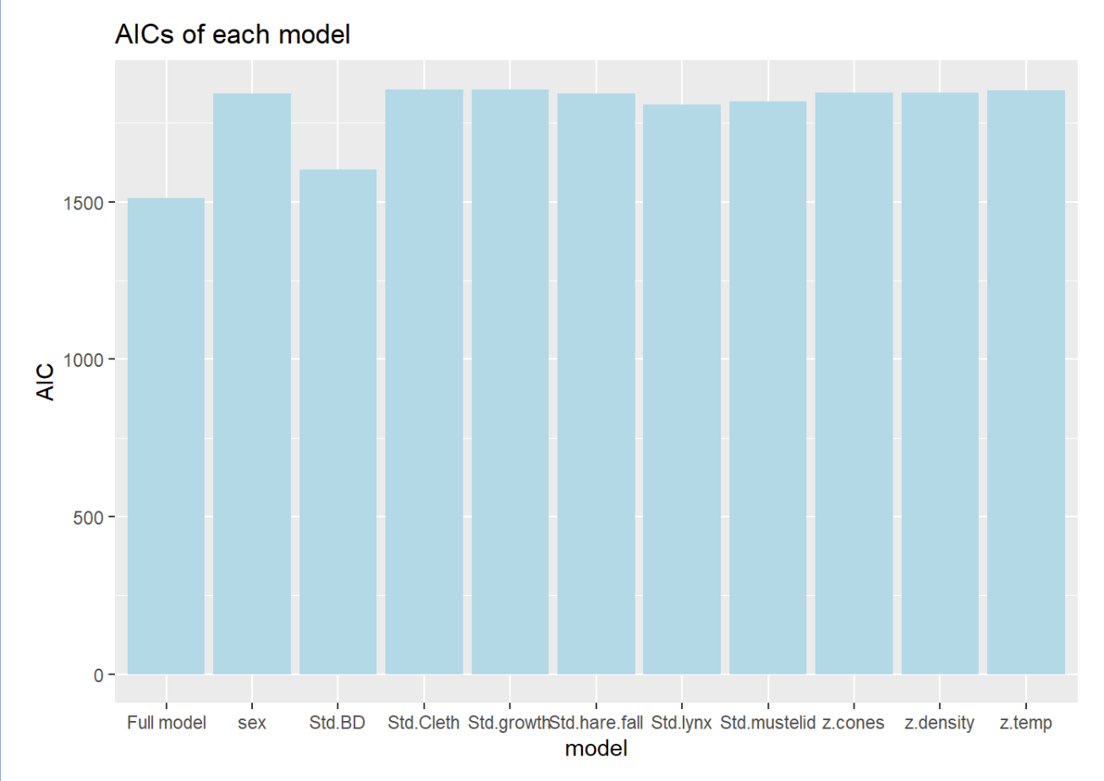
For Prediction 2:
“Full” model has the lowest AIC
Predictors collectively contribute to territory acquisition.
Among single predictors:
Std.BD has the lowest AIC
Conclusion: The null hypothesis that sex is not the biggest factor cannot be rejected.
Notes:
Although sex is important in the analysis, standardized birth date has a stronger impact on territory acquisition.

Slide 20
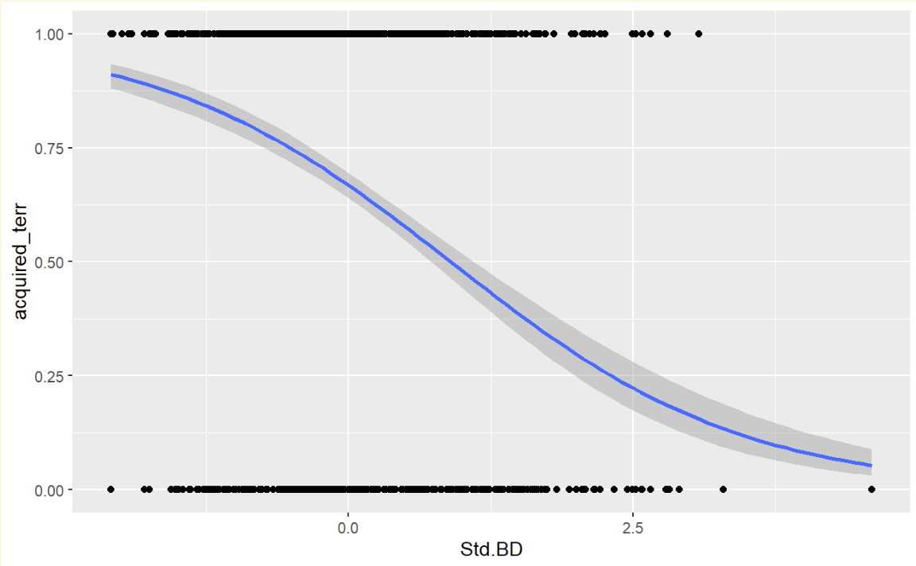
The relationship between standardized birth date and territory acquisition
Birthdate is standardized as the data are collected over decades.
Squirrels born earlier tend to acquire territory more easily.

Slide 21
Conclusion

Slide 22
Conclusion and Practical Insights
Females squirrels have a higher likelihood of acquiring a territory than males.
Focus on protecting female squirrels could ensure population sustainability
Standardized birth date has the strongest impact on territory acquisition.
Support early-born juveniles by resource management
Predator has the second-strongest impact on territory acquisition.
Manage predator populations to balance survival pressures and competition
Notes:
In conclusion, we get three key findings with important practical insights in our study.
First, females squirrels are more likely to get a territory than males.
This means if we focus on protecting and managing the place where female squirrels lives, we could further support the long-term population sustainability, since female squirrels are more likely to stay and build their territory. and having territory could help them in reproduction.
Second, standardized birthdate has the strongest impact on getting a territory.
We could interpret this as squirrels born earlier in the year have an advantage because they grow faster and face less competition.
So in real world application, if squirrels are endangered, supporting the early-born squirrels during their growth period could improve their chances of survival.
Third, predators have the second-biggest impact.
This means the presence of predators have significant effect on reducing the number of squirrels competing for territories
And by managing predator numbers and studying how squirrels adapt to them, we can create a balance that benefits the ecosystem.
Understanding how squirrels acquire territories gives us valuable ecological insights.
These three findings can be further used to guide strategies for better conservation, population management, and maintaining ecological balance.

Slide 23
Future Work
Calculate the combined effects by multiplying variables that interact
Lasso regression
A statistical and machine learning technique that combines variable selection and regularization to improve the accuracy and interpretability of a model

Slide 24
Thank you!
Hendrix JG, Fisher DN, Martinig AR, Boutin S, Dantzer B, Lane JE, McAdam AG. 2020. Territory acquisition mediates the influence of predators and climate on juvenile red squirrel survival. Pelletier F, editor. Journal of Animal Ecology. 89(6):1408–1418. doi:10.1111/1365-2656.13209. https://besjournals.onlinelibrary.wiley.com/doi/10.1111/1365-2656.13209.

